Slide 1


Experiment 6
Delta-Wye Transformer – 4 wire - Ungrounded System
Unbalanced Load
Dr. Norbert Doerry and Dr. John V. Amy Jr.
http://doerry.org/norbert/MarineElectricalPowerSystems/index.htm
© 2024 by Norbert Doerry and John Amy
This work is licensed via: CC BY 4.0 (https://creativecommons.org/)

Slide 2

Schematic
$$V_{secondary_ll}=\frac{\sqrt{3}}{n}V_{primary}=\frac{\sqrt{3}}{5.2}208=69.3 volts rms (98 V peak)$$
$I_{secondary}=\frac{n}{\sqrt{3}}I_{primary }$
(Neglecting losses)
C_{p} = 2.2 µF
R = 1200 Ω
R_{L} = 300 Ω
R_{La} = 200 Ω
R_{lamp} = 450 Ω
N = 5.2
R_{lamp}
Common Mode Current Probe
Current Meter (all phases)
Voltage Meter (all phases)

Slide 3
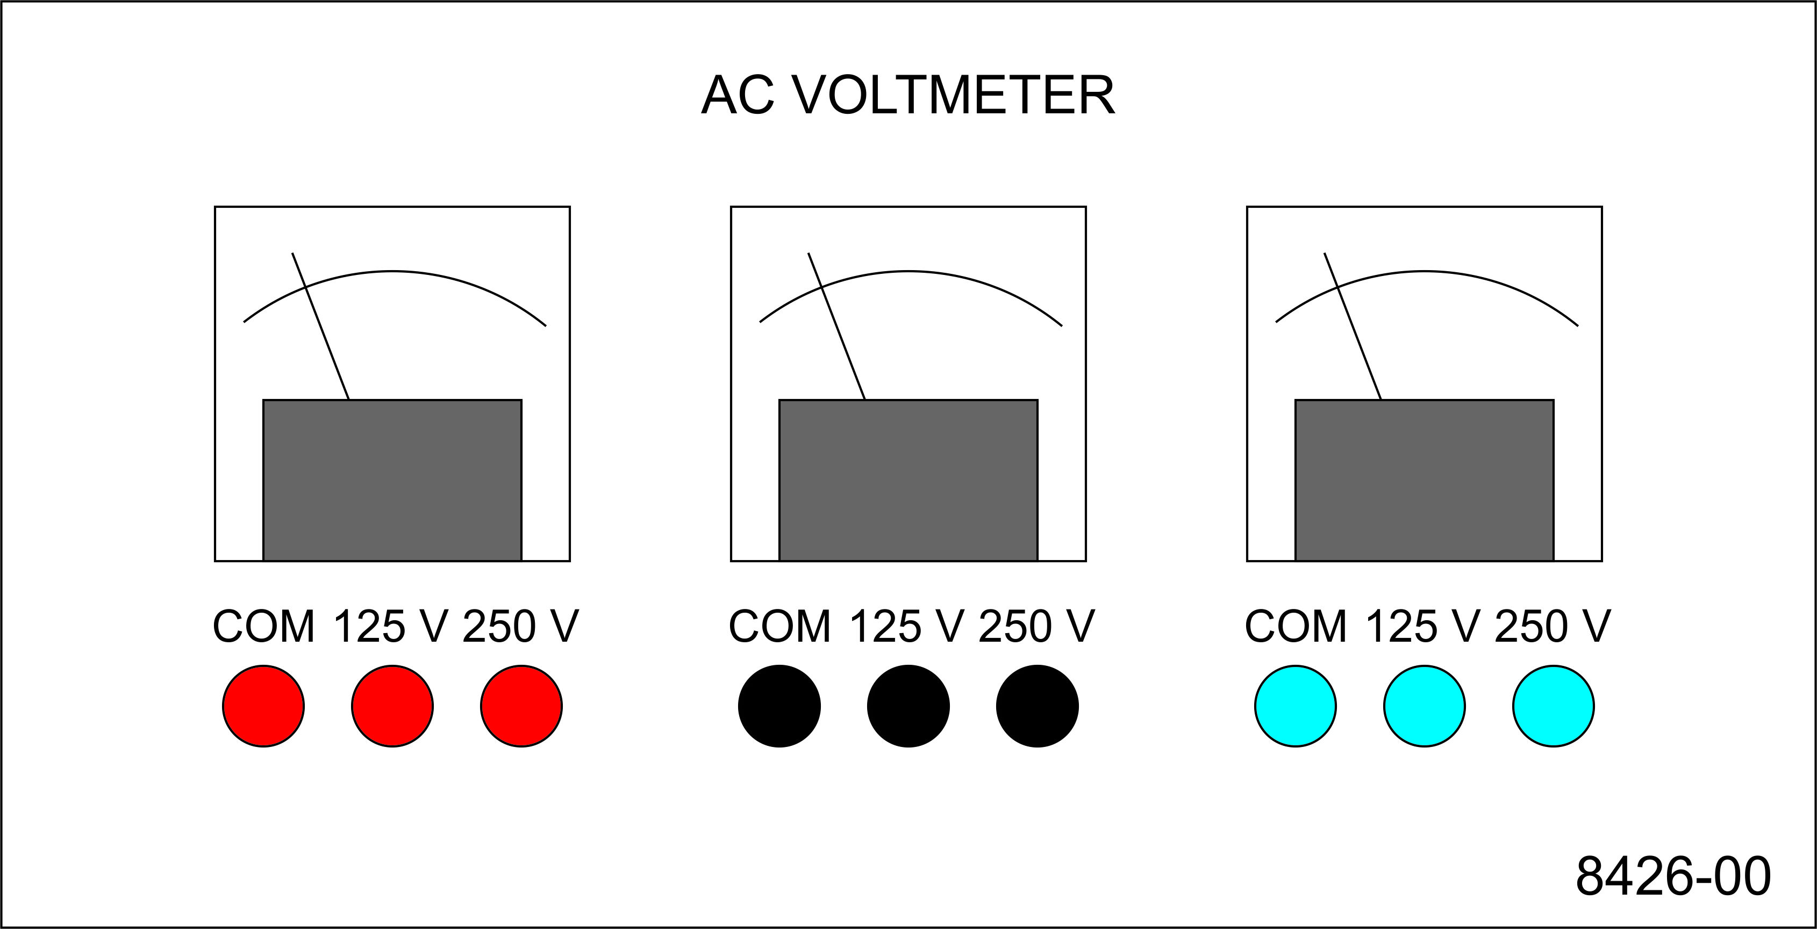
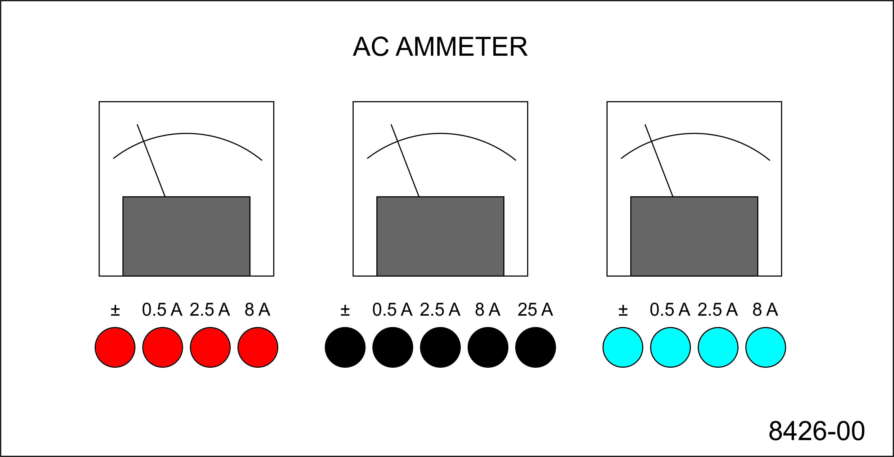
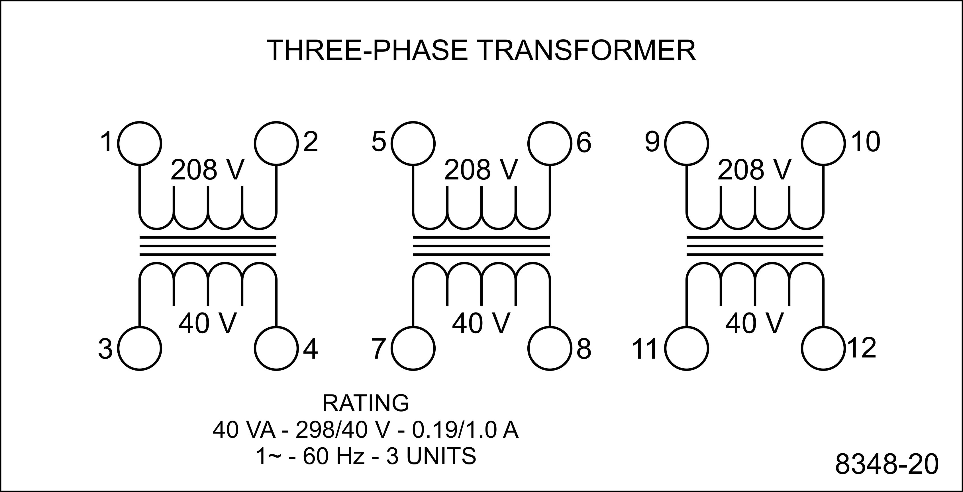
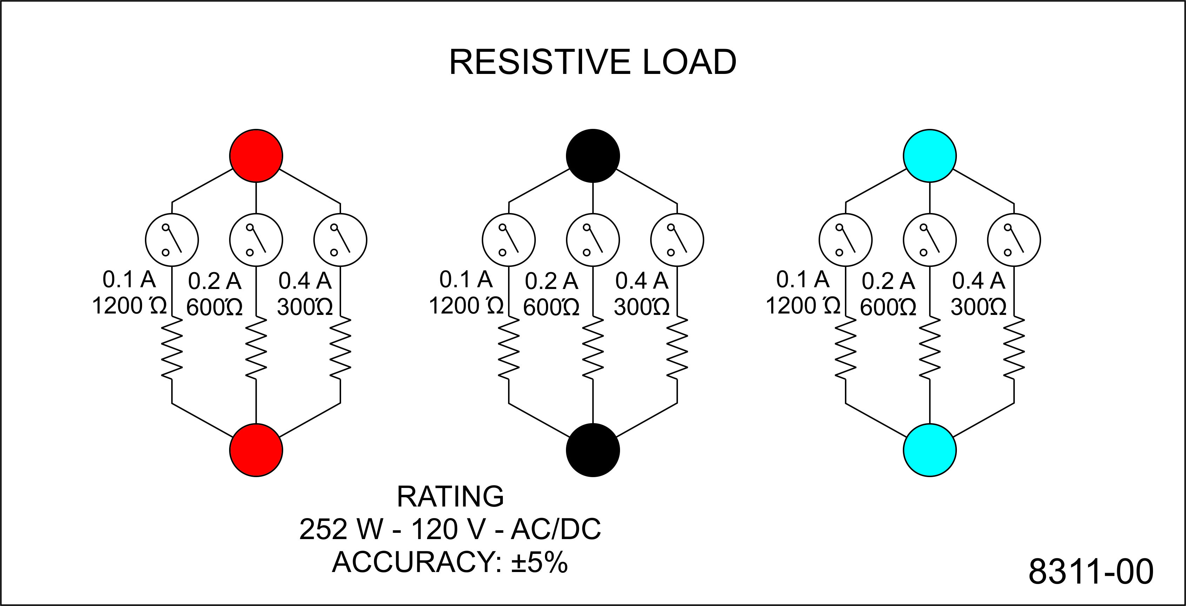
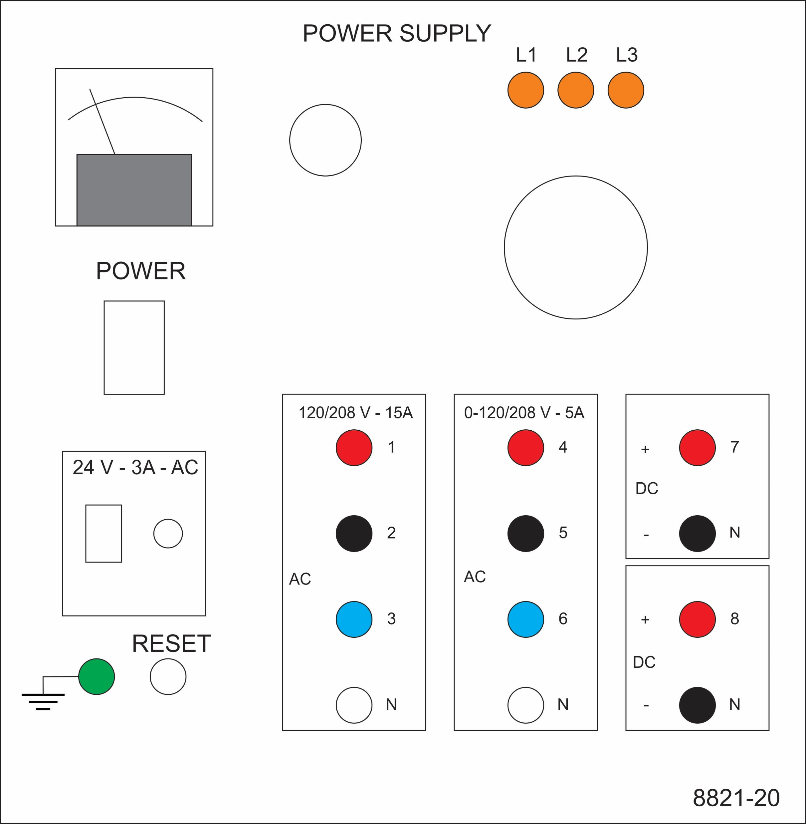
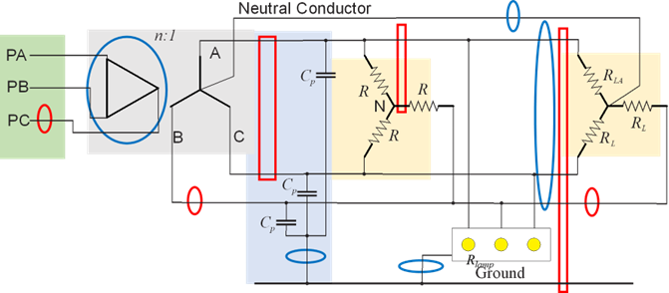
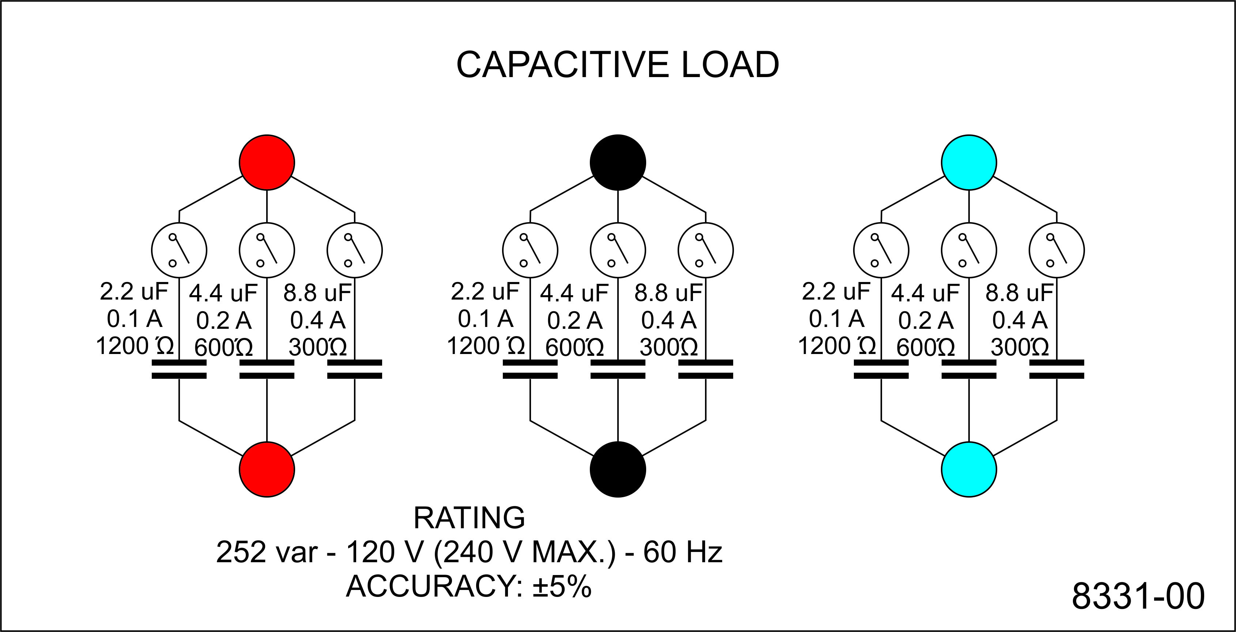
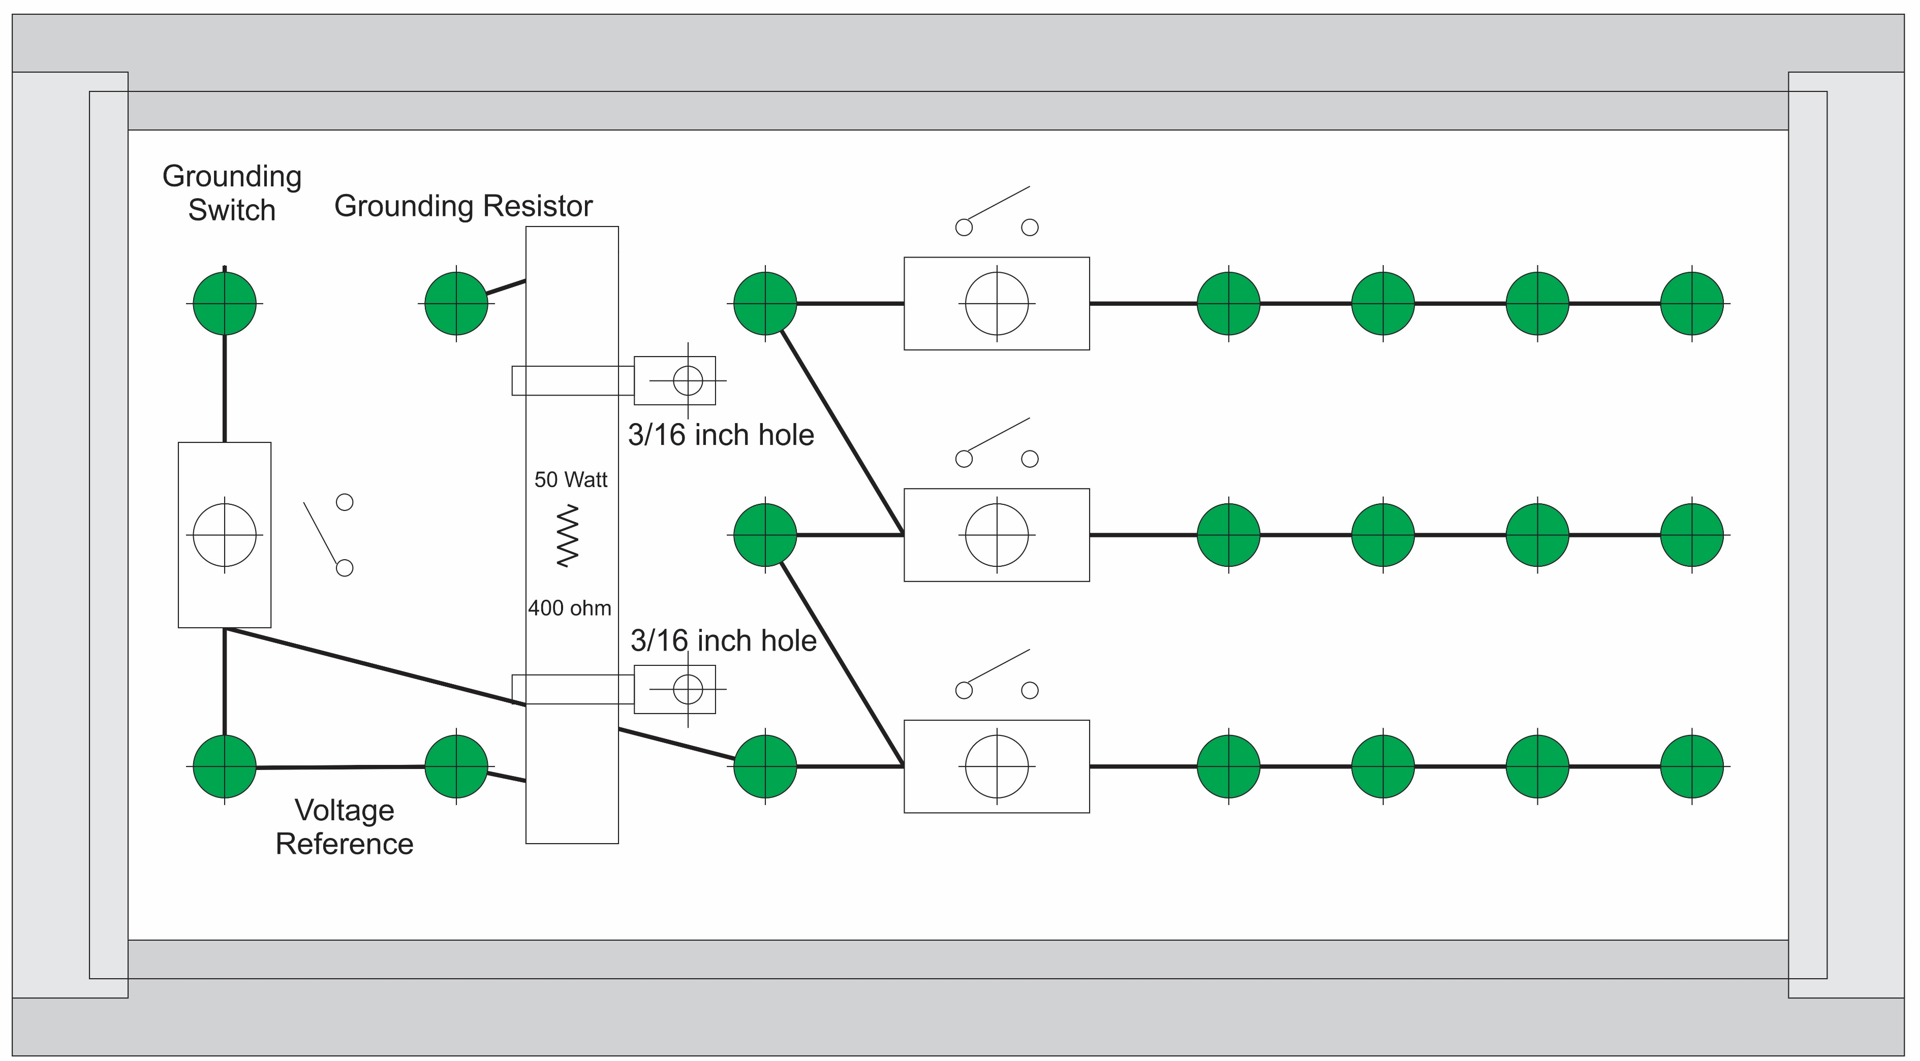
Experiment 6
Secondary - LL
Secondary - LN
Secondary - LG
Primary line
Secondary line
Load line
Wye
Wye-Load
Parasitic

Slide 4
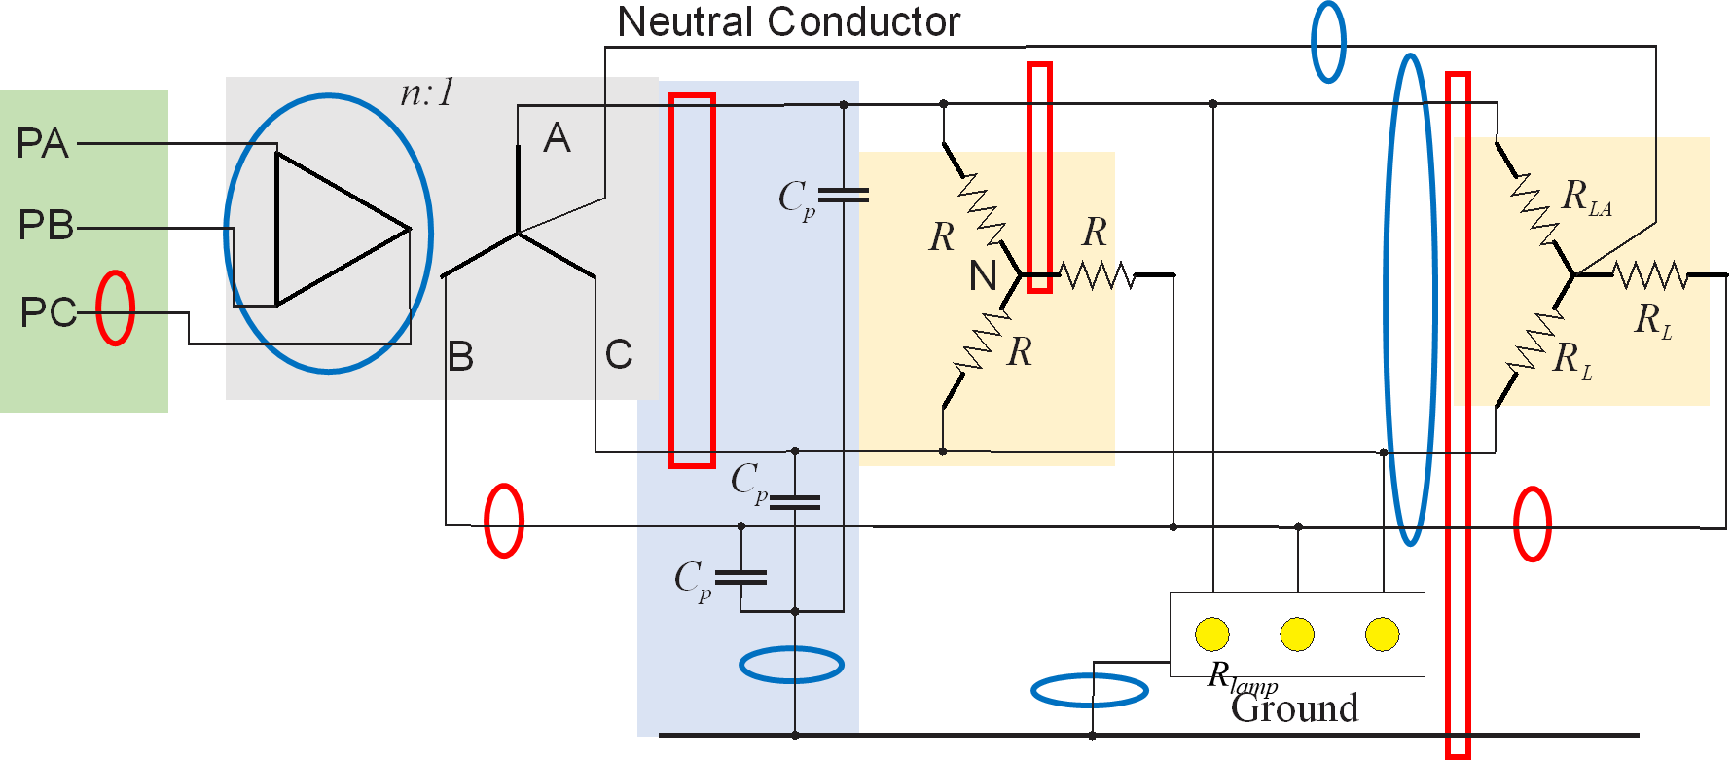
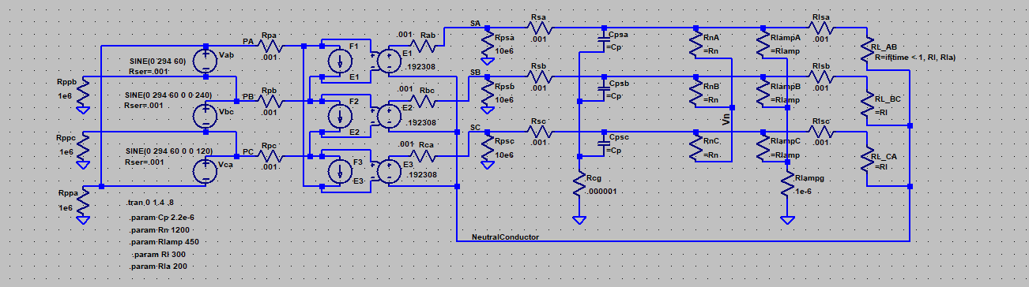
Simulation Model
LTspice
20240831 experiment 6.asc

Slide 5
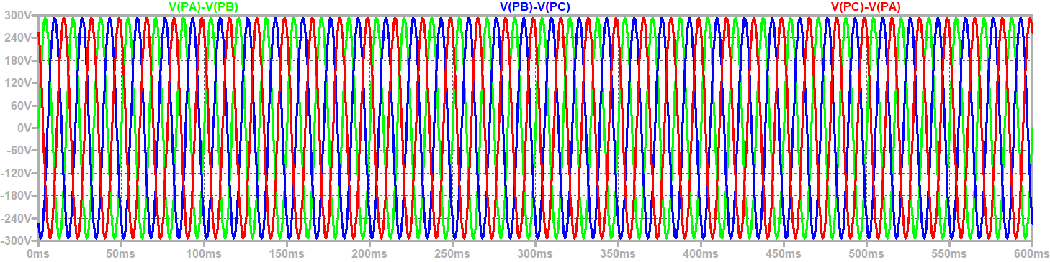
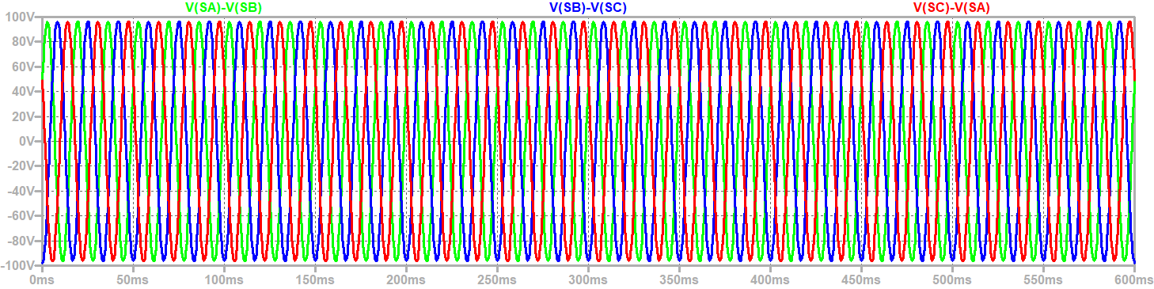
Steady State Voltages
$$V_{secondary_ll}=\frac{\sqrt{3}}{n}V_{primary}=\frac{\sqrt{3}}{5.2}208=69.3 volts rms (98 V peak)$$
Primary Line to Line Voltage: Peak = 294 volts
Secondary Line to Line Voltage: Peak = 98 V volts

Slide 6
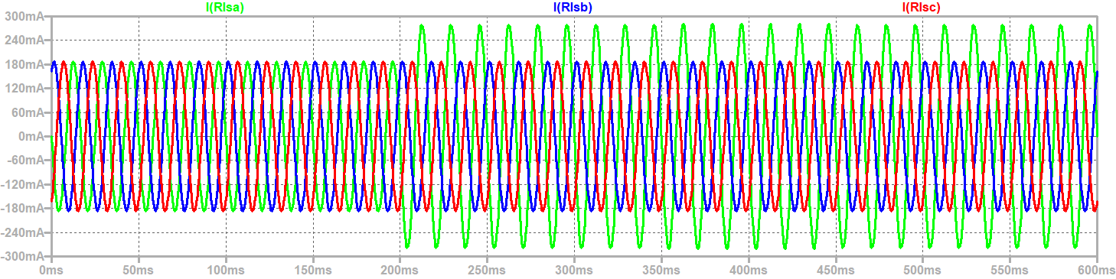
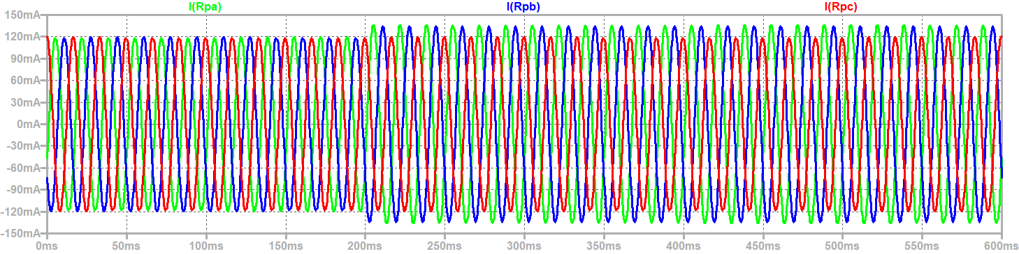
Line currents into the wye load and into primary not balanced with unbalanced load
Current into
Wye load
Circuit
Protection
on Primary may not trip with overload of a single conductor on secondary
Balanced Load Unbalanced Load
Current into
Primary

Slide 7
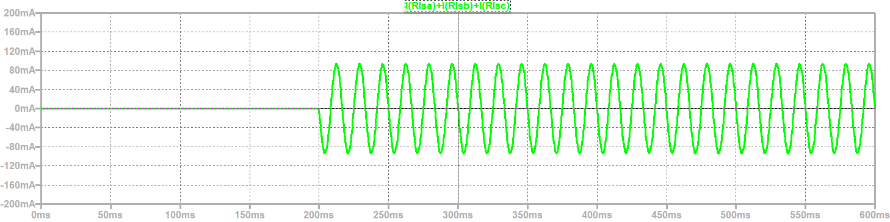
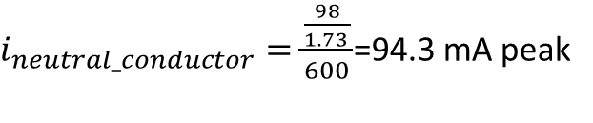
Unbalanced load results in current in the Neutral Conductor
Balanced Load Unbalanced Load
$i_{neutral_conductor}=\frac{\frac{98}{1.73 }}{600}$=94.3 mA peak

Slide 8
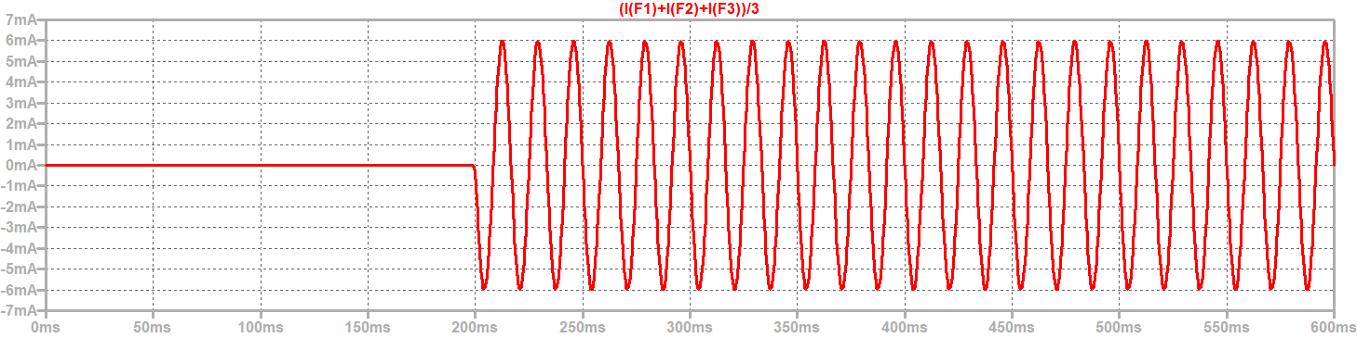
Unbalanced load results in circulating current in the delta windings
Balanced Load Unbalanced Load
$i_{circulatiing}=\frac{I_{secondary_neutral}}{3n}=\frac{94.3}{3×5.2}=6$.0 mA peak

Slide 9
Unbalanced load results in unbalanced current into the primary windings
Balanced Load Unbalanced Load

Slide 10
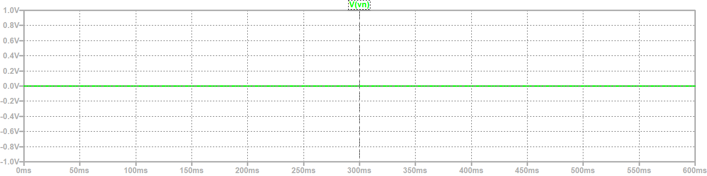
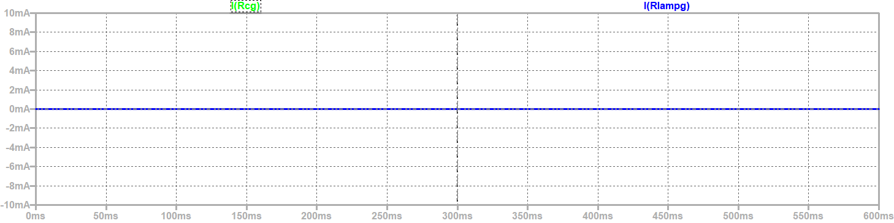
No neutral to ground voltage
(CM Voltage) or CM Current through Parasitic Capacitances or lamp resistances
Neutral to Ground Voltage
Balanced Load Unbalanced Load
CM Current through Parasitic Capacitances and Lamp Resistors

Slide 11
Wrap Up

